Slide 1
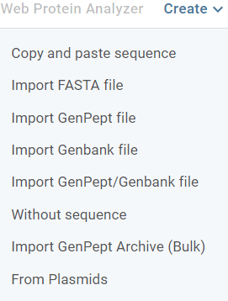
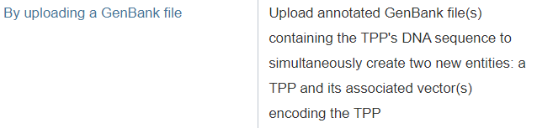

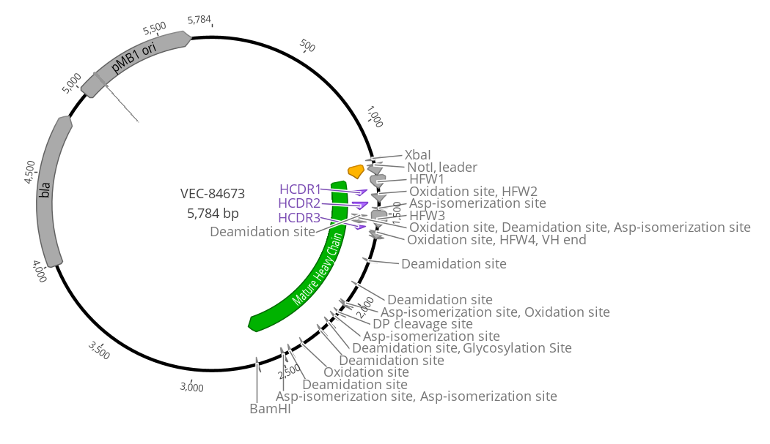
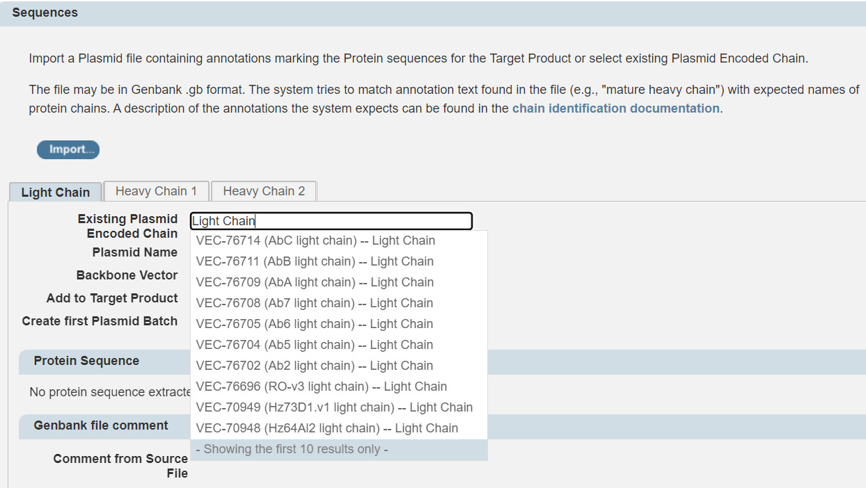
TPPs* In Genedata – Target Product
TPP is a biotherapeutic entity – mAb, bispecific, mRNA, AAV, etc.
TPPs must be associated with one or more Project
TPPs can be created by providing sequences either through upload, linking to existing plasmids (VEC) in the system, or without a sequence (which can be uploaded later)
.gb
*Genedata legacy note : TPP originally stood for Target Protein Product. A lot of Protein nomenclature remains from pre-2020 when Genedata was used exclusively for antibodies and other proteins.

Slide 2
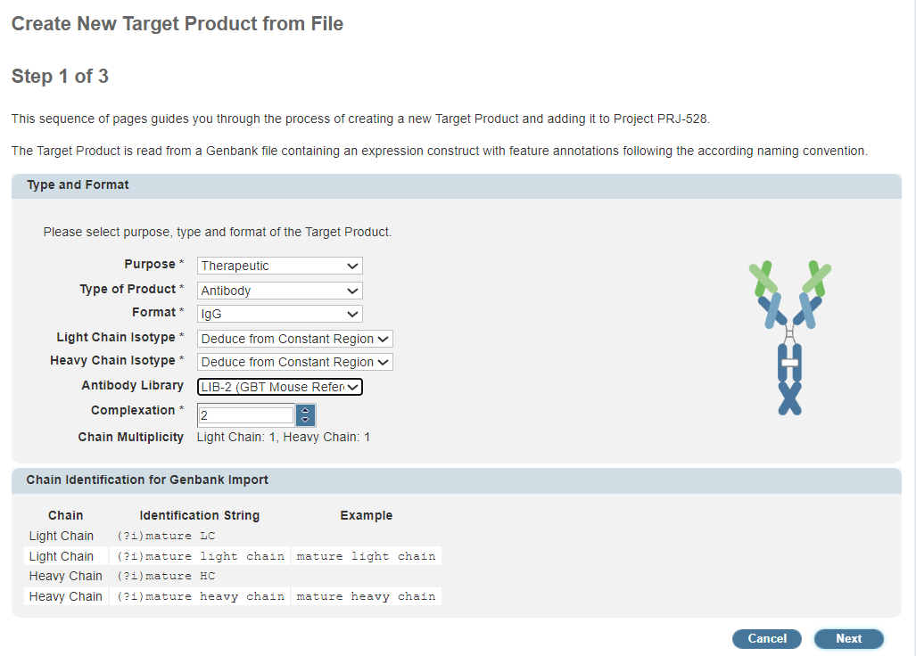
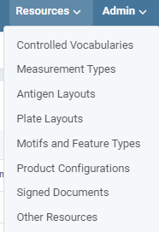
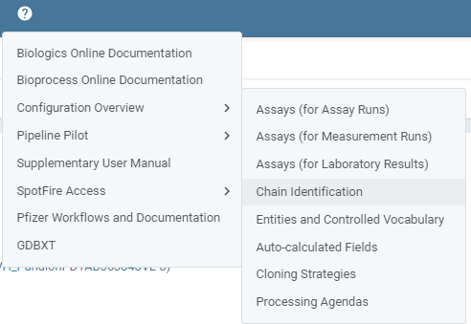
TPP - Registering Different Types of Biotherapeutics
All available formats listed in Product Configurations, Formats table
Need new format? Email DL-BMD_BIOINFORMATICS with fasta/Genbank example and image for Genedata
Formats define chains – example HC and LC for IgG
Chain annotations are interpreted by Genedata Biologics – example : extract gene of interest for mRNA by finding mature_mrna annotation
For protein chains annotation covers translated sequence; for mRNA chain annotation covers end of T7 promoter to polyA tail
When creating a new TPP need to select the right format
Antibody library important for Genedata automatic annotations of CDRs and FWRs
Complexation automatically set by format; monomer, dimer, n-mer
Chain multiplicity is number of copies of chain / complexation

Slide 3

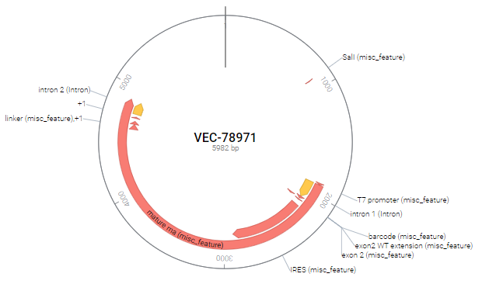
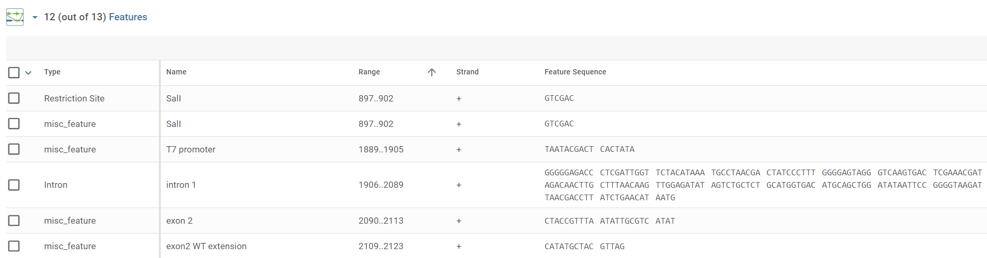
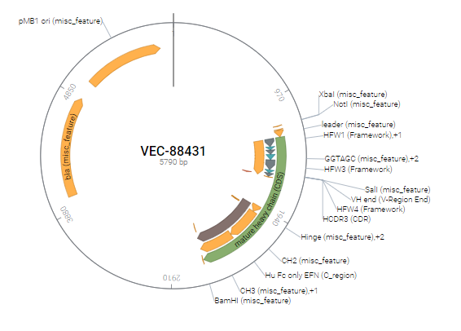
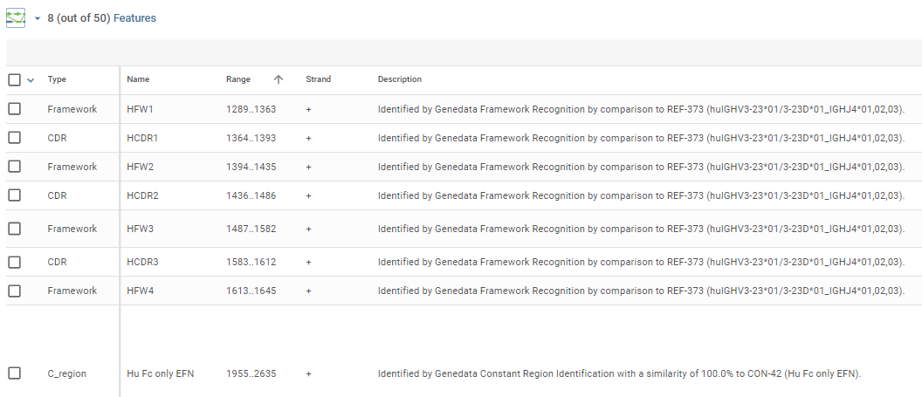
Vector (Plasmid) Registration
Plasmids are linked to a Target Product
Can be reused by linking to other Target Products
Chain annotations are interpreted by Genedata Biologics – example : extract gene of interest for mRNA by finding mature_mrna annotation
Genbank file annotations displayed as plasmid features, original and Genedata generated Genbank files can be downloaded
For protein chains annotation covers translated sequence; for mRNA chain annotation covers end of T7 promoter to polyA tail

